Slide 1
Development of two Python programs for chromosomal sequence comparison and recombination prediction
Mauricio Peñuela
September 2020

Slide 2
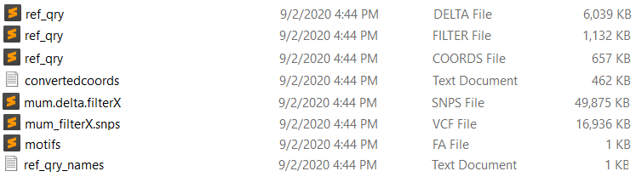
$ python preparefasta.py reference.fasta query.fasta
The mummer program is necessary to run this script. Install it using: sudo apt-get install mummer
$ python preparefasta.py reference.fasta query.fasta
$ python statsbywindow.py
type the window size you want to work. Example:
statsbywindow.py 150000
$ python statsbywindow.py 150000

Slide 4
$ python preparefasta.py reference.fasta query.fasta
The mummer program is necessary to run this script. Install it using: sudo apt-get install mummer
$ python preparefasta.py reference.fasta query.fasta
$ python statsbywindow.py
type the window size you want to work. Example:
statsbywindow.py 150000
$ python statsbywindow.py 150000

Slide 6
$ python preparefasta.py reference.fasta query.fasta
The mummer program is necessary to run this script. Install it using: sudo apt-get install mummer
$ python preparefasta.py reference.fasta query.fasta
$ python statsbywindow.py
type the window size you want to work. Example:
statsbywindow.py 150000
$ python statsbywindow.py 150000

Slide 8
$ python preparefasta.py reference.fasta query.fasta
The mummer program is necessary to run this script. Install it using: sudo apt-get install mummer
$ python preparefasta.py reference.fasta query.fasta
$ python statsbywindow.py
type the window size you want to work. Example:
statsbywindow.py 150000
$ python statsbywindow.py 150000

Slide 9
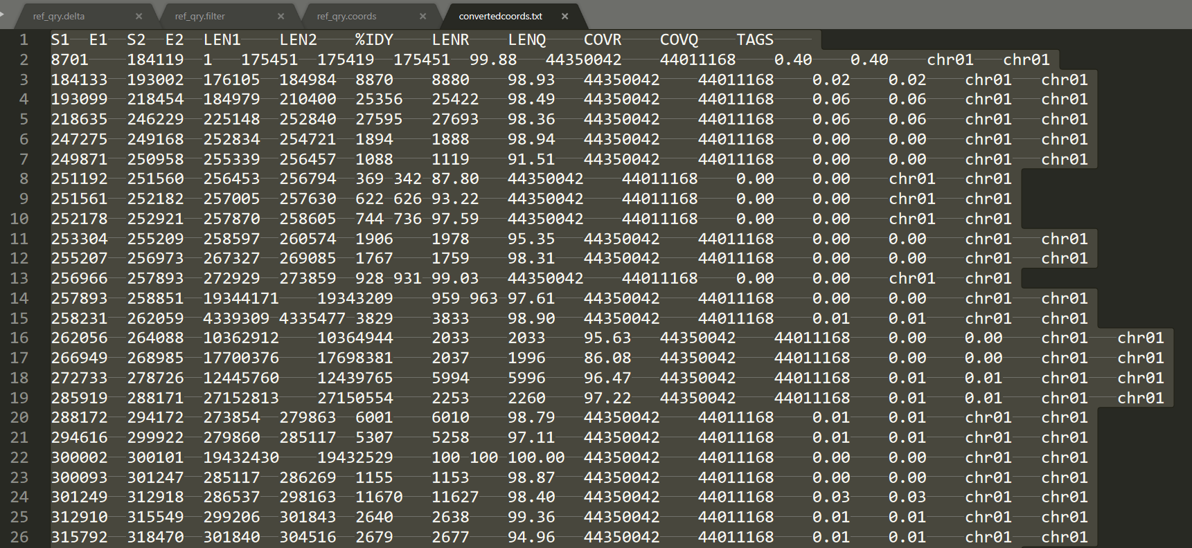

Slide 10
$ python preparefasta.py reference.fasta query.fasta
The mummer program is necessary to run this script. Install it using: sudo apt-get install mummer
$ python preparefasta.py reference.fasta query.fasta
$ python statsbywindow.py
type the window size you want to work. Example:
statsbywindow.py 150000
$ python statsbywindow.py 150000

Slide 12
$ python preparefasta.py reference.fasta query.fasta
The mummer program is necessary to run this script. Install it using: sudo apt-get install mummer
$ python preparefasta.py reference.fasta query.fasta
$ python statsbywindow.py
type the window size you want to work. Example:
statsbywindow.py 150000
$ python statsbywindow.py 150000

Slide 14
$ python preparefasta.py reference.fasta query.fasta
The mummer program is necessary to run this script. Install it using: sudo apt-get install mummer
$ python preparefasta.py reference.fasta query.fasta
$ python statsbywindow.py
type the window size you want to work. Example:
statsbywindow.py 150000
$ python statsbywindow.py 150000

Slide 16
$ python preparefasta.py reference.fasta query.fasta
The mummer program is necessary to run this script. Install it using: sudo apt-get install mummer
$ python preparefasta.py reference.fasta query.fasta
$ python statsbywindow.py
type the window size you want to work. Example:
statsbywindow.py 150000
$ python statsbywindow.py 150000

Slide 17
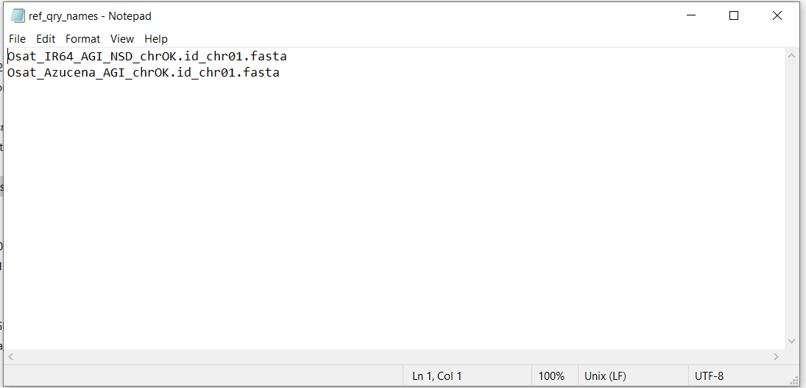

Slide 18
Here we will add the coords-traductor script developed by Camila Riccio
Will give us:
- missing query bases in reference
- Inversions in query
- bases not aligned
Will complete the stats by window which are:
- SNPs
- Indels
- rGC & qGC count
- Motifs
This program will consume the majority of computational resources but will bring all the files necessary to extract the information
This program will consume few computational resources and will allow the user run it several times changing the window value
when the programs are complete, we will begin to propose the mathematical models to predict recombination based on the statistics

Slide 19
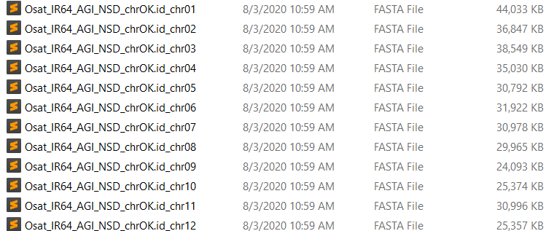
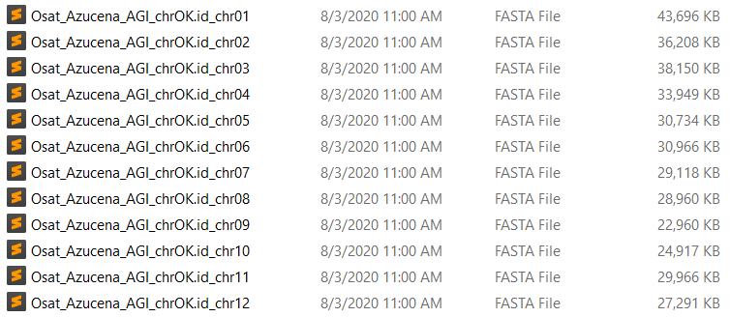
Now, to compare genomes we need to use references coords
Aligned by Mummer

Slide 20
How use these coords?
Chr 1 IR64
Chr 1 Azucena
Pos r | Base r
1 | A
2 | T
3 | C
… | …
n | N
Pos q | Base q
1 | C
2 | C
3 | T
… | …
n | N
COORDS FILE
S1 E1 S2 E2
1 10 30 40
115 143 60 90
Pos r | Base r | Pos q | Base q
1 | A | 30 | A
2 | A | 31 | A
3 | T | 32 | T
4 | C | 33 | C
5 | T | 34 | T
6 | G | 35 | G
… | … | … | …
10 | N | 40 | N
This subset has to be extracted for each line of coords.
The last step is to combine these subsets one after other in a big data frame
Task to go crazy
Aprox 40 Million of bases
in each chromosome and
5209 coords lines
The idea is extract subsets of query data using Pos r, example:
Extract cells from Chr1 Azunacena between Pos q (30-40), and put them together in a dataframe with cells from 1 to 10 from IR64
This will give a result as:
…

Slide 21
After got crazy for several days, we discover this simple method
COORDS FILE
S1 E1 S2 E2
1 10 30 40
115 143 60 90
Base/Motif | Pos q | Pos r
A | 35 | 5
TTTTTTTTT | 77 | 131
For Base A in Pos q 35 -> Search interval in query coords
Difference between Pos q and S2 -> 35-30 = 5
Add this difference to S1 => 1 + 5 = 6
Subtract one = > 6 – 1 = 5 This is the position in Pos r
For Motif TTTTTTTTT Pos q 77:
77 – 60 +115 – 1 = 131 Pos r

Slide 22
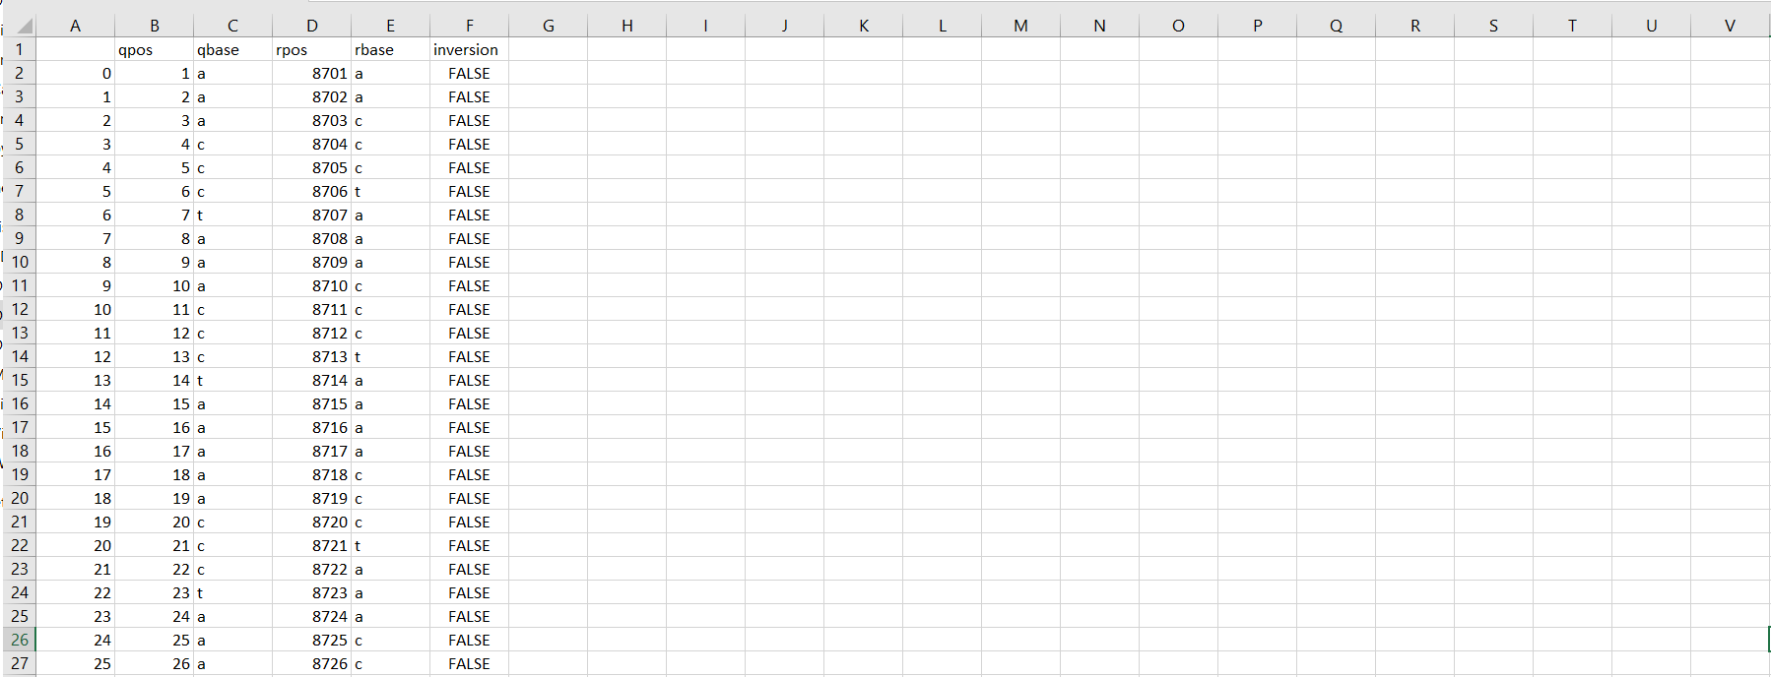
This table shows 85% of aligned query bases, others need to be adjusted by the presence of overlapping contigs

Slide 23
